Slide 1

!! Bubble sort !! algorithm & implementation in java
-- #greenlearner --

Slide 2
Input/output
Input
Unsorted integer elements
Output
Sorted integer array
9 | 7 | 6 | 4 | 3
3 | 4 | 6 | 7 | 9

Slide 3
Steps/Algorithm
9 | 7 | 6 | 4 | 3
Start from the first element(i=0,1,2..length-1)
Start from j=0
Compare j^{th} and (j+1)^{th} element
If j^{th} > (j+1)^{th} – swap these elements
Else leave as it is
Now Move to next element and repeat above 2 steps
Start from the first element again and repeat above steps up to (length-i-1)

Slide 4
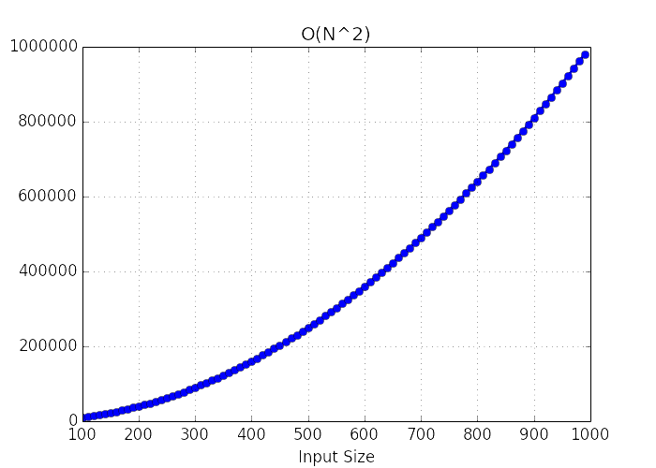
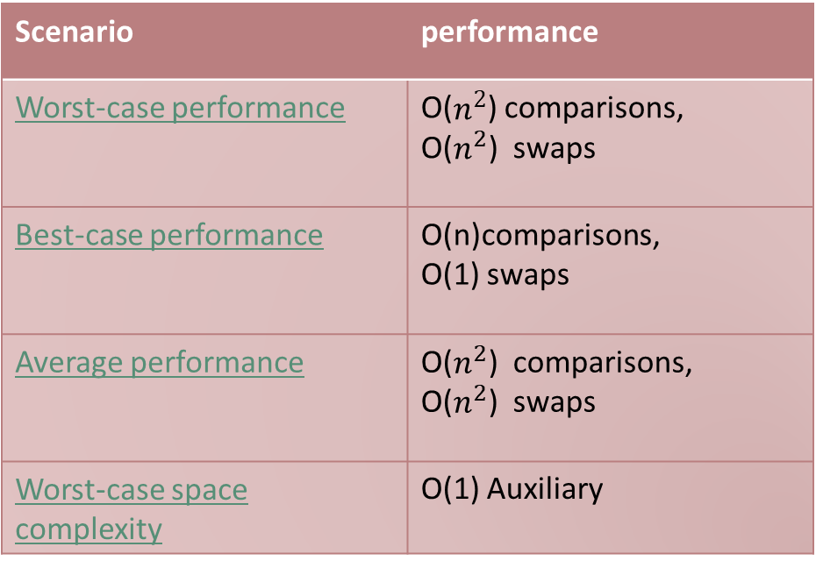
Performance
Scenario | performance
Worst-case performance | O($n^{2}$) comparisons, O($n^{2}$) swaps
Best-case performance | O(n)comparisons, O(1) swaps
Average performance | O($n^{2}$) comparisons, O($n^{2}$) swaps
Worst-case space complexity | O(1) Auxiliary

Slide 5
Where and when to use??
the algorithm is simple, it is too slow and impractical for most problems even when compared to insertion sort.
Bubble sort can be practical if the input is in mostly sorted order with some out-of-order elements nearly in position.

Slide 6
References
https://en.wikipedia.org/wiki/Bubble_sort

Slide 7
Next..
Insertion Sort..

